Slide 1


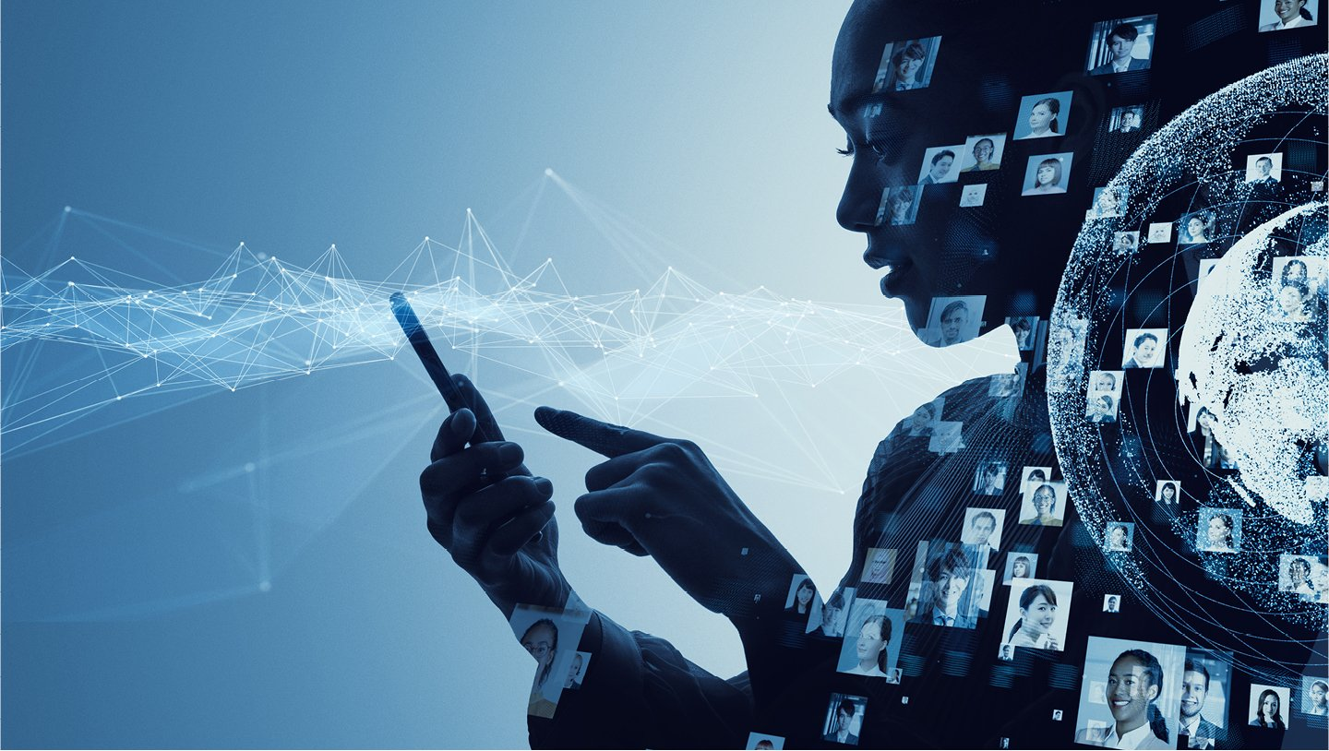

State-of-the-art Deep Learning Models for Speech Recognition
Venu

Slide 2
Contents
Abstract
Intoduction
Industry applications
Exploring Neural Network Types for Speech Recognition
Exploring the Top Neural Network Applications
Future developments, Limitations and Solutions
Conclusion

Slide 3

Abstract
Speech recognition technology has advanced significantly in recent years, with deep learning models playing a critical role in boosting accuracy. This research investigates the various deep learning models used in speech recognition and assesses the performance of existing implementations such as Google Home, Siri, and Alexa. It also looks at their limitations and potential advances, making it a promising area for future innovation.

Slide 4
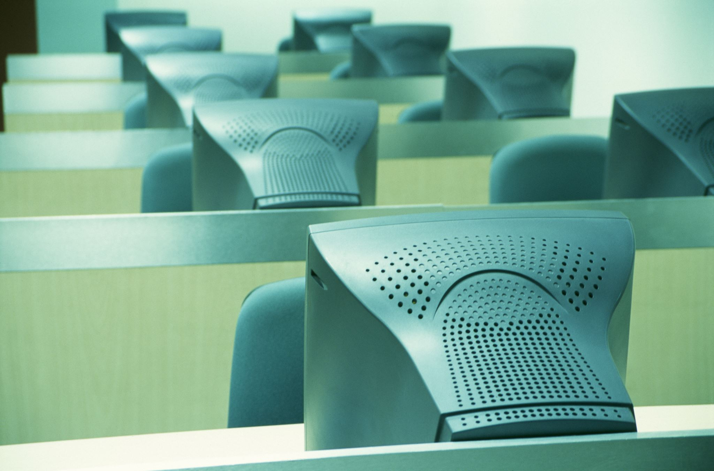
introduction
Speech recognition is an important technology in human-computer interaction (HCI). It is the process of turning a speech signal into a sequence of words using algorithms implemented as computer programmes. Since the 1960s, computer scientists have been working on voice recognition, but the scope and capability of these early systems were restricted. This research study will focus on deep learning models for speech recognition, with a specific application in mind. It will investigate the existing constraints of deep learning models in this field, as well as potential remedies to these restrictions.

Slide 5

Industry applications
Healthcare: transcribing medical dictation, automate administrative chores
Security: authentication based on voiceprint
Finance: automating financial operations, real-time advice
Manufacturing: boosting production and worker safety, voice commands for equipment management and safety incidents recording
Retail: improving customer service and inventory management with voice commands
Education: improving accessibility for impaired students, automatic transcription of lectures

Slide 6
Exploring Neural Network Types for Speech Recognition
Neural networks are mathematical models that simulate the behavior of the human brain, consisting of interconnected "neurons" that work together to analyze and process information.
DNNs are neural networks that contain multiple hidden layers between the input and output layers, allowing for more complex and abstract representations of data to be learned.
Deep Belief Networks (DBNs) are deep neural networks trained in an unsupervised manner, used for tasks such as feature learning, classification, and dimensionality reduction.
RNNs are neural networks that process sequential data by maintaining an internal state that captures information about previous inputs, allowing them to make predictions or classifications based on the context of the entire sequence.

Slide 7
Revolutionizing Virtual Assistants: Exploring the Top Neural Network Applications
Goggle HOME, A market-leading system for processing user requests using neural network models uses multichannel processing, acoustic modeling, Grid-LSTMs, and cloud computing to interpret user demands in noisy environments.
Apple's Siri virtual assistant recognizes and interprets user voice commands using deep neural networks, allowing users to summon the assistant without physically touching their device.
Amazon's voice-controlled virtual assistant uses a two-step neural shortlisting-reranking approach to find the best relevant skill for a given voice query.

Slide 8

Future developments, Limitations and Solutions
Google Home, Alexa, and Siri have advanced natural language processing, machine learning, and speech recognition capabilities. Each system has its own strengths and features, but limitations include internet access, privacy concerns, and reliability issues. Solutions could include improving offline capabilities, strengthening privacy policies, and enhancing security measures. Innovation and research are needed to address these challenges and improve voice-based AI systems.

Slide 9
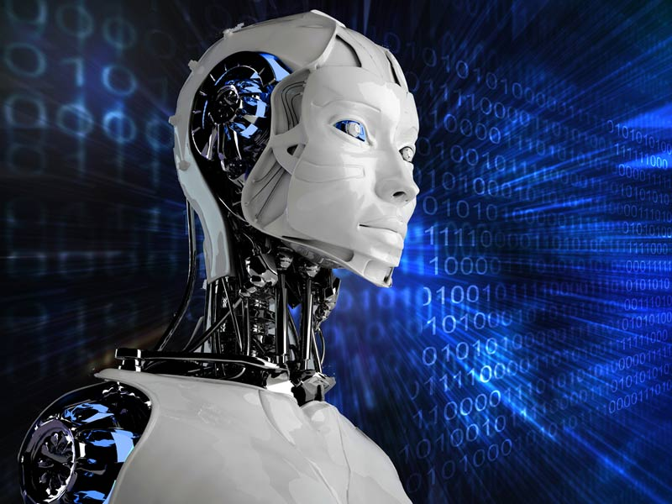
Conclusion
Voice recognition technology has evolved significantly due to the development of neural networks and deep learning techniques. It is being used to automate operations, increase safety, and improve customer experience in industries such as healthcare, transportation, security, and customer service. With the continued development of neural networks and other machine learning technologies, we may see even more powerful voice recognition applications in the coming years.

Slide 10
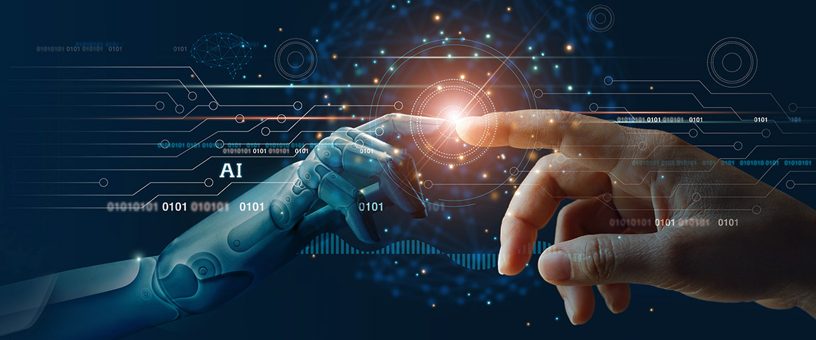
Thank you

